Slide 1
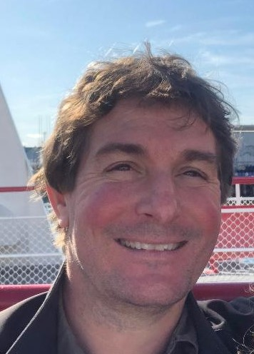
Joe Ivanic
Computational Scientist, Advanced Biomedical Computational Science
My Experience
30+ years experience in Quantum Chemistry
Developed many high-level theories/methods
Used quantum chemistry for health research
Worked at DoE, DoD, & NCI/NIH
Education
BS, Mathematics/Chemistry, University of Melbourne
PhD, Quantum Chemistry, University of Melbourne
About Me
I grew up in the remote Australian Outback
I like running/sports, cooking, crosswords, coffee
I’ve played guitar for 40+ years (rock & classical)

